Slide 1

Week 12
LO.4 - Developing a range of core employability skills reflecting compassion, values and behaviours.

Slide 2

Aim;
Critically analyse progress in developing a range of core employability skills reflecting compassion, values and behaviours.
Learning outcomes;
At the end of this lesson students will be able to:
Exploring values and principles in adult social care.
Analysing the role of reflection for employability skills in health and social care practice

Slide 3
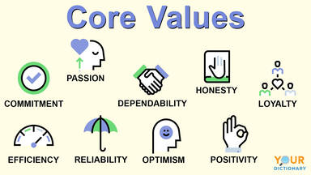
key values and principles of adult social care

Slide 4
Short video clip on care values
https://www.youtube.com/watch?v=zRPM_pqaPp4
Identify key values and principles of adult social care

Slide 5

Introduction to the values and principles of adult social care

Slide 6
What are the 7 principles of care?
1 - Promoting effective communication and relation. ...
2 - Promoting anti discriminatory practise. ...
3 - Maintaining confidentiality of information. ...
4 - Rights to dignity, independence, empowerment, ...
5 - Acknowledging individuals beliefs and identity. ...
6 - Protecting individuals from abuse. ...
7 - Providing individualised care.

Slide 7
Now the definition:
A principle - is often described as a ‘basic truth’ or a basic guide to the right way to act or behave, for example, you should always be honest with people.
So, principles can be described as rules or standards of good behavior
Values - beliefs about what is right or important.
In an adult social care setting like a care home, it could be a standard or quality considered worthwhile or desirable that impacts on the way that staff work.
For example, social care staff value the ‘individual’ and place them at the heart of the service. This is often called a ‘person centered service’.
Health and social care workers share a set of values and follow a set of principles in order that the service they provide to the individual is of a consistently high quality.

Slide 8
CARE VALUES
Are beliefs about the right ways to treat patients or service users
When all the values are put together, they make up the care value base
All health, social care and early years workers should respect the care value base
Promoting anti-discriminatory practice
Maintaining confidentiality of information
Promoting and supporting individuals rights to dignity, independence and safety

Slide 9
Cond…
Acknowledging individuals personal beliefs and identity
Protecting individuals from abuse
Promoting effective communication and relationships
Providing individualised care
It is important that carers recognise there own values and beliefs, but also understand how others values and beliefs may differ, and recognise why this may be.

Slide 10
Activity
Care Values
Principles of care
Why is it important for health care practitioners to always promote these principles and values at all times?

Slide 11

Why principles and values is important in health care sector
For workers in the care sector to provide a good quality service to their service users, it is important for them to share a set of VALUES (belief systems)
These values form the ‘value base’ which in turn enables staff to follow a set of principles (rules or standards of behavior) and therefore ensure a high level of care.
Principles and values are often described in legislation, policies and procedures, codes of practice and other documents.

Slide 12

Cont.…
In order to give the best possible care, social care workers treat people as individuals. We are not all the same and as such we should be treated in a way that meets our individual needs
In order to deliver a high standard of care it is important that social care workers work to consistent values and principles.
Service users deserve high quality, individual care

Slide 13

Reflecting value
Your values reflect what is most important to you, in the way you live and work.
Identifying and understanding your values can help you determine your priorities in life.
Acknowledging your values when exploring opportunities or making plans and decisions can make both your professional and personal life happier and more fulfilling.

Slide 14
How do I work out what my values are?
The list of potential values is endless! Respect, ambition, health, and adaptability are just a few examples.
You need to narrow down your choices -- try the Barrett Values assessment in the links below. Looking at a list of values will make it much easier and will help you to think about your own values and behaviours.
Barrett Values Centre Has some useful materials on values.
Personal values assessmentA five minute test produced by the Barrett Values Centre.

Slide 15

If you are writing about your values, you need to give evidence in the form of examples from your own experiences. This will help you to explain to others why certain values are important to you.
Have a look at the examples below, the values are in bold:
‘My part time job in a care home has taught me the value of adaptability and not worrying if things don’t always go to plan!’
‘Joining several voluntary organisations has made me realise that I feel happier and more fulfilled when I am part of a team.’
‘My role as line manager in an elderly care home helped me to see how important making a difference is to me.’

Slide 16

Reflecting for employability
A key element of being successful in today’s society is building your employability. Reflection is an essential part of this process.
Reflection is a skill that can serve you well throughout life. It can benefit you while being educated, developing while working, and it can support you with entrepreneurship and building up your general ability to get employed and be adaptable and successful, i.e. your employability.

Slide 17
Discuss the role of reflection within CPD in relation to a reflective practitioner
The role of reflection within CPD is to help a reflective practitioner reflect on their day-to-day practice and enables them to analyze why and how they do things, and to consider whether other approaches might benefit them and their practice.
Reflection is used within CPD to help a reflective practitioner develop their knowledge and skills and make sense of the work they do as a youth worker, care worker or nurse.
For example, a reflective practitioner might reflect on a specific session or activity they had in their work placement and consider how they could have run the session differently to enable better understanding for the young people, service users or patients.

Slide 18
Discuss the role of reflection within CPD in relation to a reflective practitioner
The role of reflection is to enhance personal development by leading to self-awareness. For example, if the focus of reflection is improvement in patient care, it helps expand and develop clinical knowledge and skills of a reflective practitioner.
Clinical knowledge is a wide range of knowledge that nurses use to achieve patient care. This includes knowledge from biological sciences, such as physiology, and knowledge from social sciences, such as psychology.
Skills that nurses use are communication skills that enable them to use their knowledge for the benefit of patients.

Slide 19
Discuss the role of reflection within CPD in relation to taking responsibility for own learning and professional growth
Reflection enables more ownership of the learning taking place. It raises the effectiveness and efficiency in an ever changing and complex health-care system through practitioners analyzing, examining their own practice. It reminds qualified practitioners that there is no end point to learning about their everyday practice.
For example, to take responsibility for their own learning and professional growth, a youth worker, care worker or a nurse can reflect on their practice by choosing one learning experience they had in work placement to identify areas of needs using a reflective model, such as Gibbs’ reflective cycle.
They can identify their areas of needs by evaluating their strengths, weaknesses, opportunities, and threats to address those needs, skill gap by doing a SWOT analysis and taking the opportunity offered to develop relevant skills/experience by doing training or Functional Skills Courses in Maths, English and ICT and learn from that experience.

Slide 20

contd…
You should use evidence from your practice, including research, audit, patient and colleague feedback, and other quality improvement information, to reflect accurately on your performance and that of your team.
You should then commit to making any necessary improvements to your own and your team’s work as part of your professional development.
In due course, you should reflect on whether your CPD activities have helped you to meet your objectives and, if not, whether you need to do any further learning or other activities. Research suggests that committing to improving performance in this way is more likely to lead to changes in behaviour

Slide 21
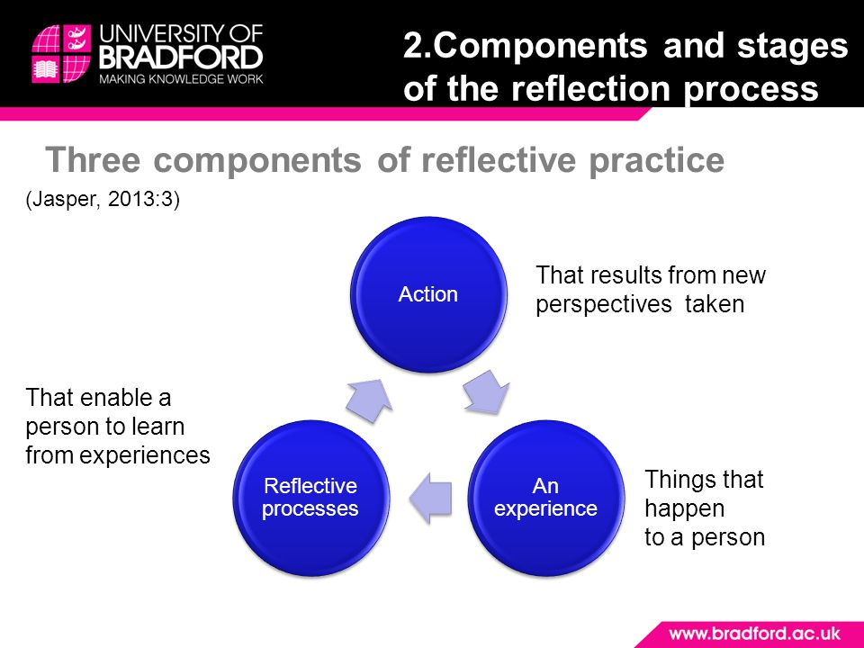
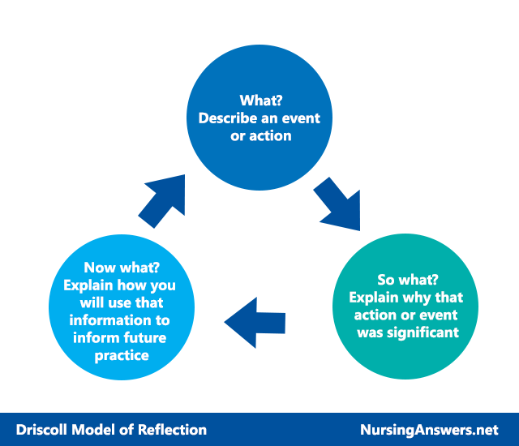
Exploring ERA and Driscoll Model of Reflection

Slide 22
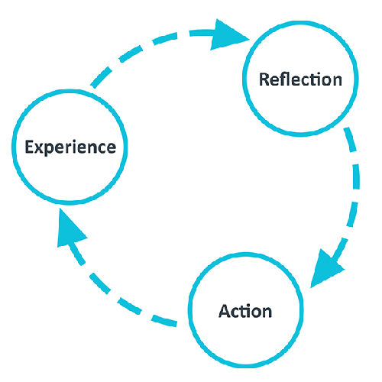
ERA model
Some people think of reflection as a process that is applied to distinct, individual experiences. The basic process follows the ERA model – Experience, Reflection, Action – and almost all other reflective models have a similar underlying structure that expands on this.

Slide 23
The John Driscoll Model of Reflection is a framework for reflection, developed into a structured process to guide reflection. Driscoll's (2007) model is designed for the learner guide their own learning by reflecting on the event using the three questions, with the addition of guidance regarding what should be incorporated at each stage pf the model.

Slide 24
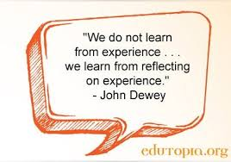

Slide 25


Slide 26
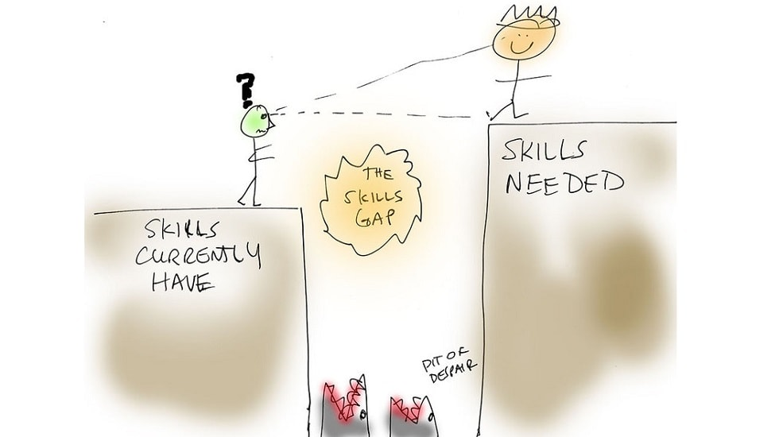

Slide 27
Developing employability often means using reflection to make the most of experiences – these can be from university courses, work (full-time or part-time), interests, volunteering, or caring responsibilities.
Reflection can help you to identify what skills you have utilised and developed through these experiences and build your sense of self-awareness.
An important aspect of employability arises when you manage to combine all your experiences, your skills, and self-awareness into a story that is explicit to you and that you can effectively and positively communicate to others.
Reflection will help you to surface otherwise unknown elements of your employability story
One element common to both employability and reflection is the idea of drawing out learning, development, and abilities that would otherwise have remained unrecognised and unknown.
Reflection is often identified as the mechanism for making the implicit explicit to ourselves.
Reflection is essential for building employability

Slide 28
Reflection is essential for building employability-Cont…
For instance, when working you might often have to rely on effective interpersonal communication when engaging with patient/service user’s, and may have on multiple occasions had to deescalate building conflict.
People in those situations sometimes fail to identify ‘conflict management’ as one of their skills, and often do not recognise such experiences as examples of effective interpersonal skills, even when asked in job interviews.
Reflection would in that situation help you to identify your strengths and become aware about how to weave them with specific examples into your employability story.

Slide 29

Ways reflection can help with your employability
Reflection can help you to:
identify the type of experiences and abilities you already have and those you are likely to need to become more employable
Identify your strengths and weaknesses and find specific situations where you have deployed them such that you can effectively communicate them to others.
Track your improvement of skills you want to develop and need for succeeding in your chosen careers

Slide 30
Make informed decisions about what you think success is and looks like to you personally
Identify things that you find stressful and how to deal with them – this way building resilience, a key ingredient to effective and long-term employability.
Moreover, by reflecting on and ensuring that you are developing these key attributes, you are likely to get an edge around employability.
Ways reflection can help with your employability-cont…

Slide 31

Using the Reflectors’ Toolkit to build employability through reflection
You can use different elements of the Reflectors’ Toolkit to build and strengthen your employability. Key sections are reflecting on experiences, reflecting on goals and objectives, building a reflective habit, and building self-awareness through reflection. Developing these will contribute to your success.
Reflecting on experiences will help you to identify learning and build an understanding and knowledge base of how you act in a range of situations – this will be valuable when communicating about your past experiences in the job market, and give you a range of situations to draw strategies from.
Reflecting on goals and objectives will help you track development of skills as well as of progression towards what you want in life – this will help you both communicate about and develop skills that are required to succeed in different careers.
Building a reflective habit makes you able to quickly identify successes and mistakes and allows you to fix them immediately – a valuable skill in any profession.
Increased self-awareness can ensure that you are navigating the job market in a way which aligns with who you are and who you want to be – especially defining what success looks like for you, becoming aware of your strengths and weakness, your values, and developing an ability to set reflective goals can make you successful

Slide 32

Specific things to reflect on for employability
It can be extremely helpful to routinely reflect on what skills you have developed over the last week/month/year and how you will be able to evidence these skills with examples.
To identify the skills that are required in the sector you want to end up in and start developing these by setting goals and objectives.
Reflect on how you deal with challenges and how you can improve your approach.
Reflect on the range of experiences you have and find ways to expand this range.
Ensure you reflect and find value in the things you do regularly.
Often people forget that the things they find easy/or do frequently actually require a lot of skill.

Slide 33

Ensure that you don’t neglect learning
Some people might think that working part-time jobs in bars/grocery stores or being active with hobbies do not build their employability.
The reality is that when a reflective mindset is adopted, you will be able to find value and learning in most situations – and realise that all your experiences help to build your unique employability story.

Slide 35

Presenting your assignment
Title page-Your student number, the module and submission date
Content page
Introduction
Font –Ariel, Times New Roman
Font size -12
Line spacing – 1.5
Paragraphing-Not too short or too long
Page number
In text referencing using Harvard referencing style
Reference list using Harvard referencing style
Reference list should be in alphabetical order
Proof read for grammar errors
Submit as a single document i.e. a word document or Pdf
Conclusion

Slide 36
https://www.ed.ac.uk/reflection/reflectors-toolkit/employability

